Slide 1


University Carpooling Platform
Jessica,,Rida, Rudra, Suhayb, Youssef

Slide 2

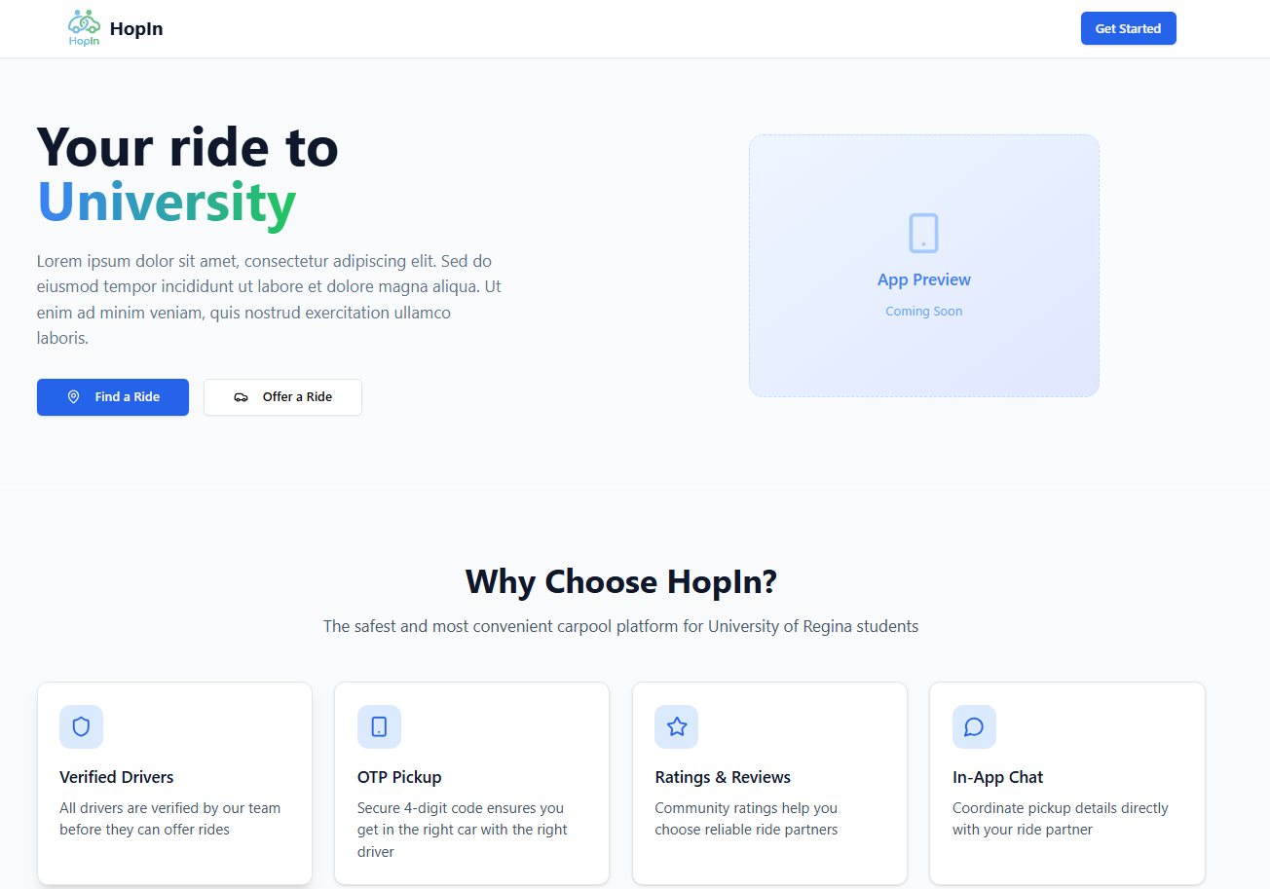
Why, How, Who, What
Commuting to university can be a challenge due to rising transportation costs, limited public transit, and car issues, especially in the winter. HopIn addresses these challenges by connecting drivers with available seats to riders seeking reliable and safe transportation.
With the university student in mind, HopIn gives users a smooth experience finding people in their area to either offer a ride, or get a ride to the university.

Slide 3


Slide 4
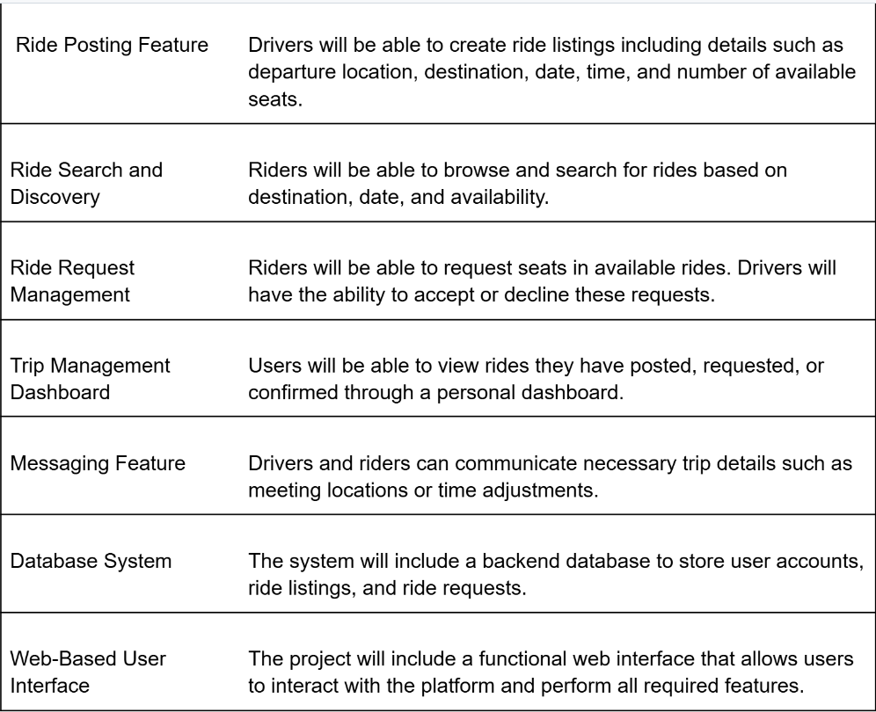
Project Planning Methods
Decided to focus on 7 core features
Excluded:
Integration with external payment system
Liability management
24/7 customer support
Project Scope Statement: Project Deliverables

Slide 5
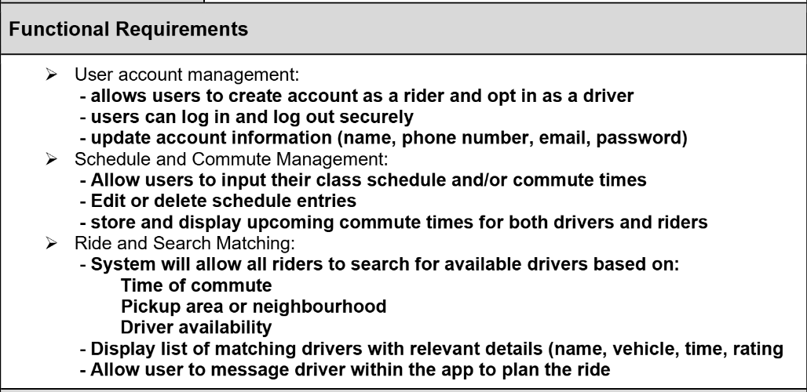
Project Planning Methods
First we established the requirements and the required event handling
Establishing parameters
Designed the front end and back end architectures
Focused on models, followed by coding
Project Requirements Document: Functional Requirements

Slide 6
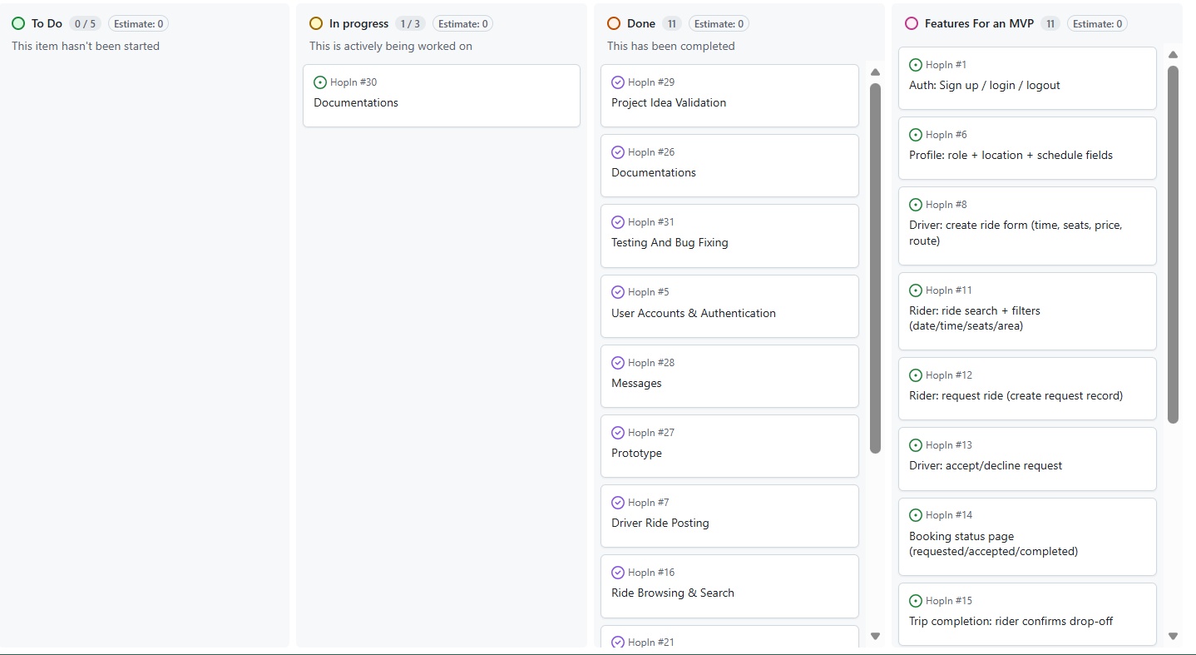
Project Planning Methods
Utilizing Kanban, direct communication, and meeting minutes to track progress

Slide 7
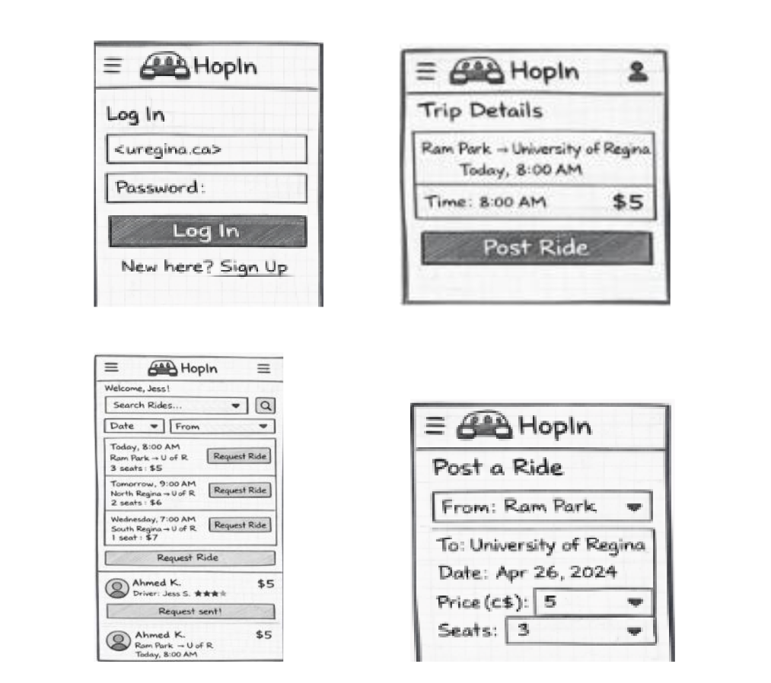
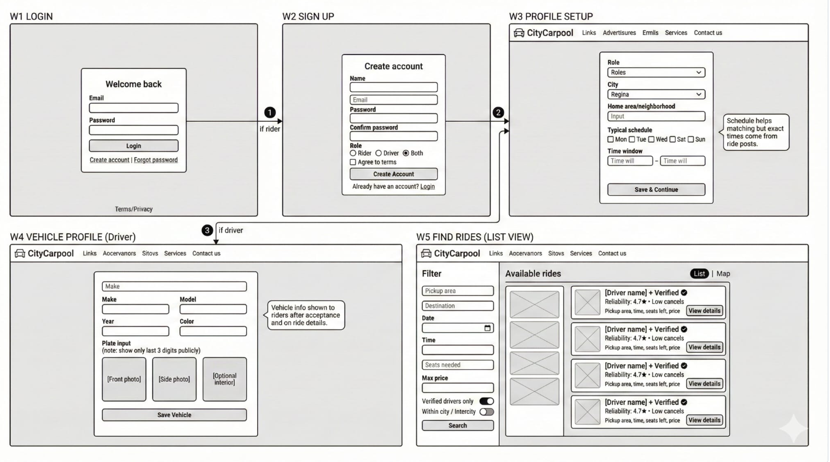
Front End Design
Lo-fidelity Prototypes
(front end architecture)

Slide 8
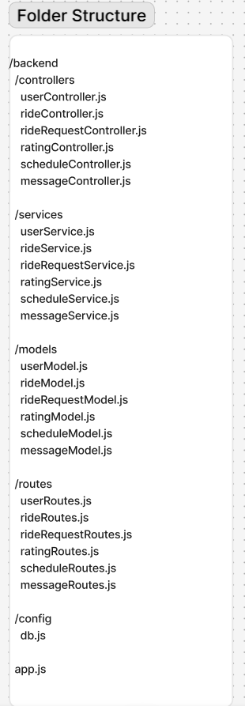
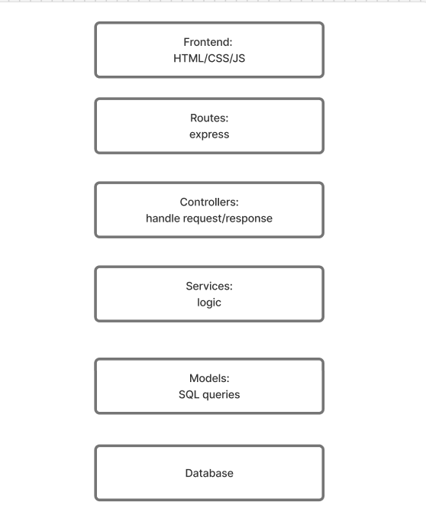
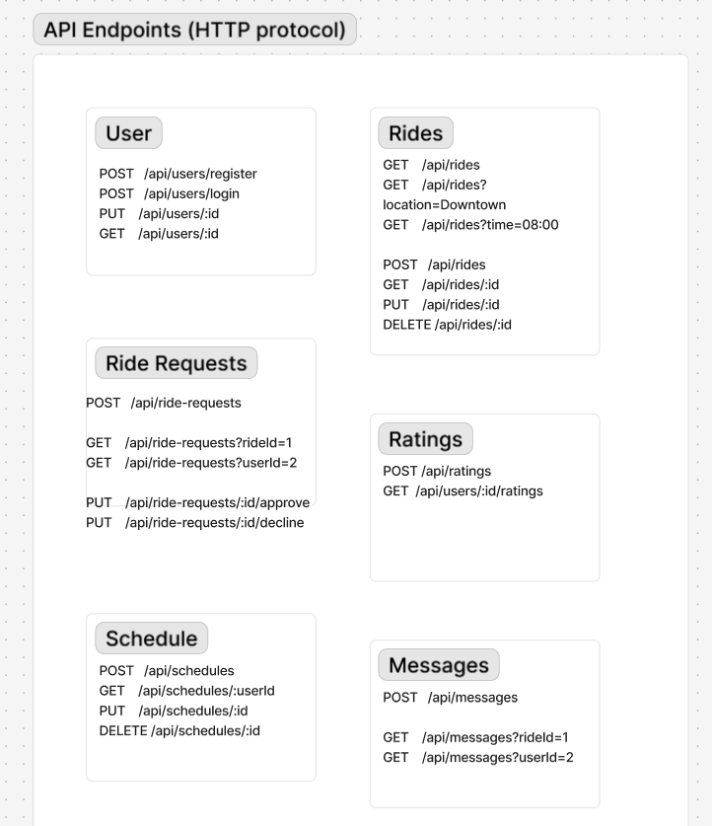
Tech Stack and
Back End Architecture

Slide 9
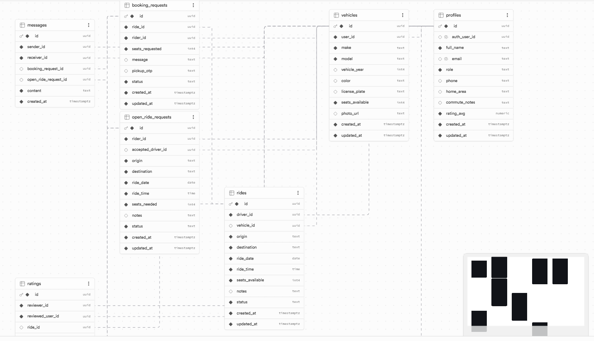
Back End Architecture

Slide 10
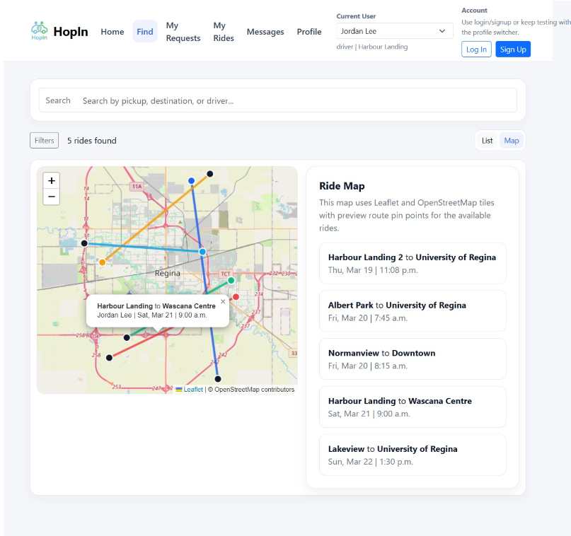
Future MVP
GPS tracking of the drivers
Integrated external payment system
Drivers license authentication
24/7 Chat Support
Data protection measures
(more abstraction and embedded processes)
Expand to other universities

Slide 11
THANK YOU!
Questions?
Or
Feedbacks

